Slide 1

Slide by Amandine and Pietro 24/02/24

Slide 2
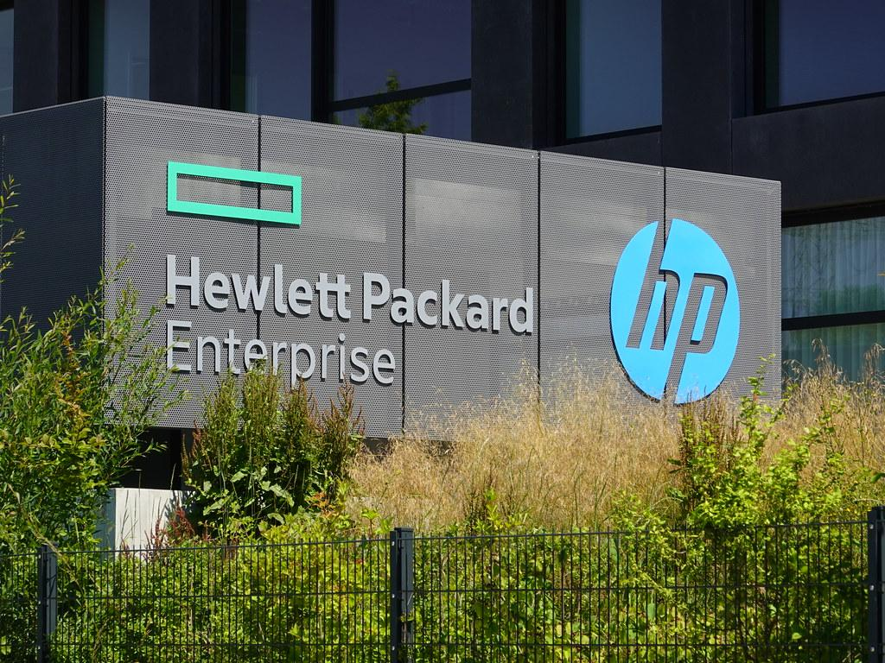
HP company
Hewlett-Packard Company, officiellement abrégée en HP, est une entreprise américaine fondée en 1939. Cette société produisait à l’origine des composants électroniques et d’instrumentation. La marque HP a rapidement évoluée vers la fabrication de postes informatiques, d’imprimantes et de serveurs.

Slide 3
HP slogan célebre:
<<’’ HP invent ’’ >>
Fondateurs : William Hewlett, David Packard
Siège social : Palo Alto, USA
Produits principaux: Ordinateurs fixes, portables, moniteurs, imprimantes, calculatrices…

Slide 4

The logo

Slide 5
Pure description Logo
Forme: un cercle bleu claire
Police: 2 lettres en miniscule et en italique, de couleur blanche.

Slide 6
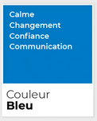
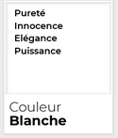
Interpretation logo
Un logo minimaliste, lisible avec une vrai identité.
Les lettres hp font références au fondeurs Hewlett-Packard.

Slide 7
Hp description logo
In 2012, the HP logo adopted a softened palette, replacing the solid blue shade with a pastel sky-blue, which looked tender, friendlier, and more welcoming. Although the letters on the logo remained intact, they had a thinner look with a new background.
The HP logo, like many iconic logos in the world, has undergone numerous changes to capture the minds of the audience. Although this icon may be apparently simple, it’s cautiously designed to have a direct impact on the consumers. The tilted letters don’t just make the logo memorable, but also demonstrate their quick delivery and commitment to innovation.
What’s more, HP’s decision to have the letters extend outside the circular background is a purposeful choice. By doing this, HP has showcased its ability to think outside of the box and reinvent things, which is a key identifier in the tech world. Of all things that made the HP logo memorable, the most important one is its simplicity. Clean yet remarkably attractive!

Slide 8
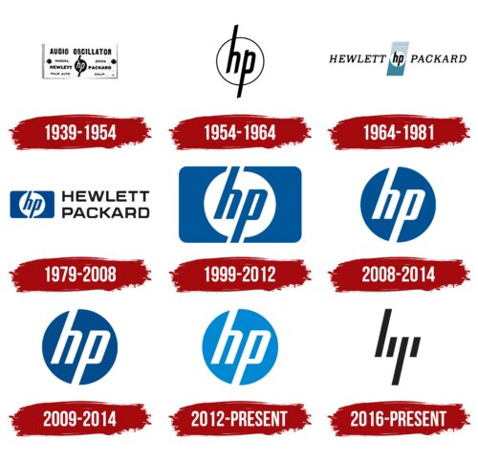
…. L’ evolution du logo……depuis le 1939

Slide 9
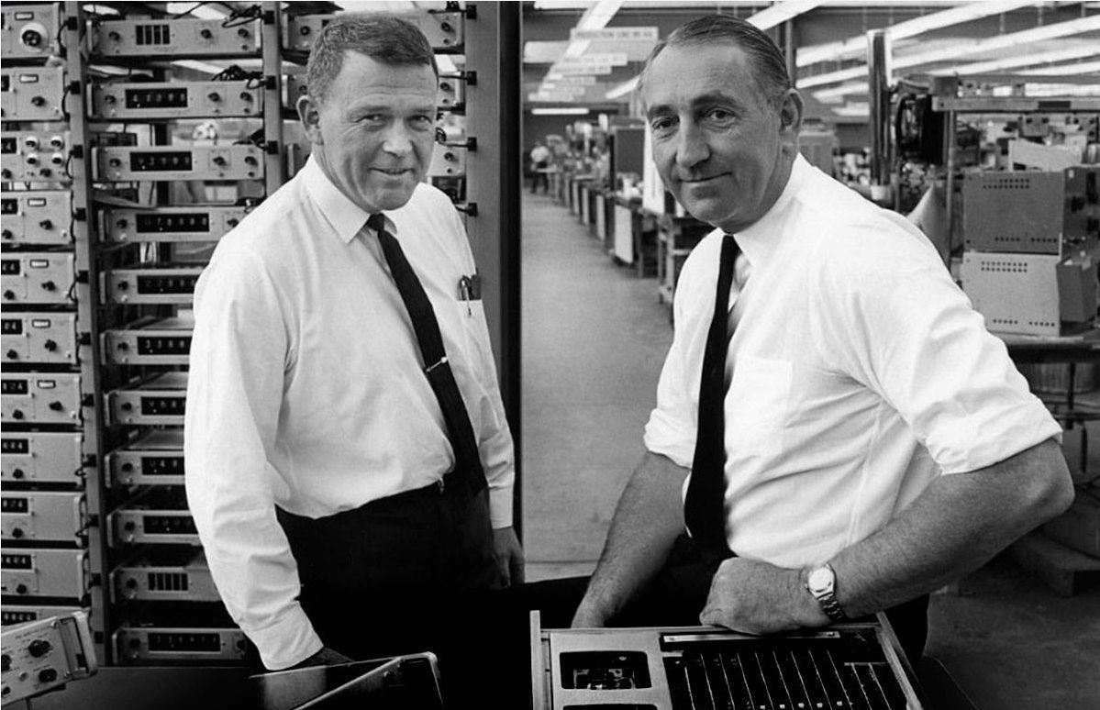
William Hewlett and David Packard

Slide 10

Hp website

Slide 11
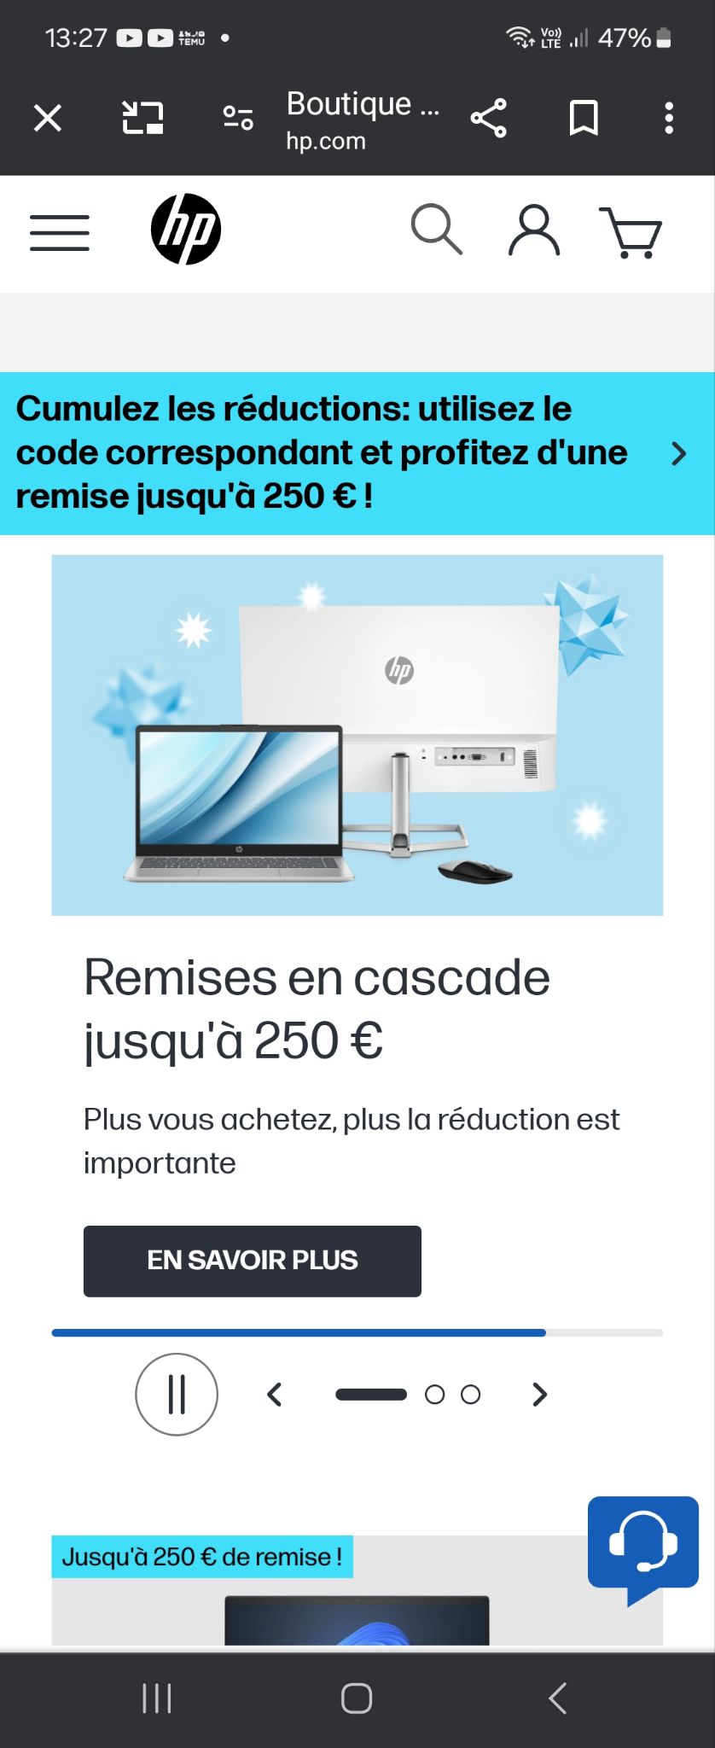
Hp app mobile

Slide 12
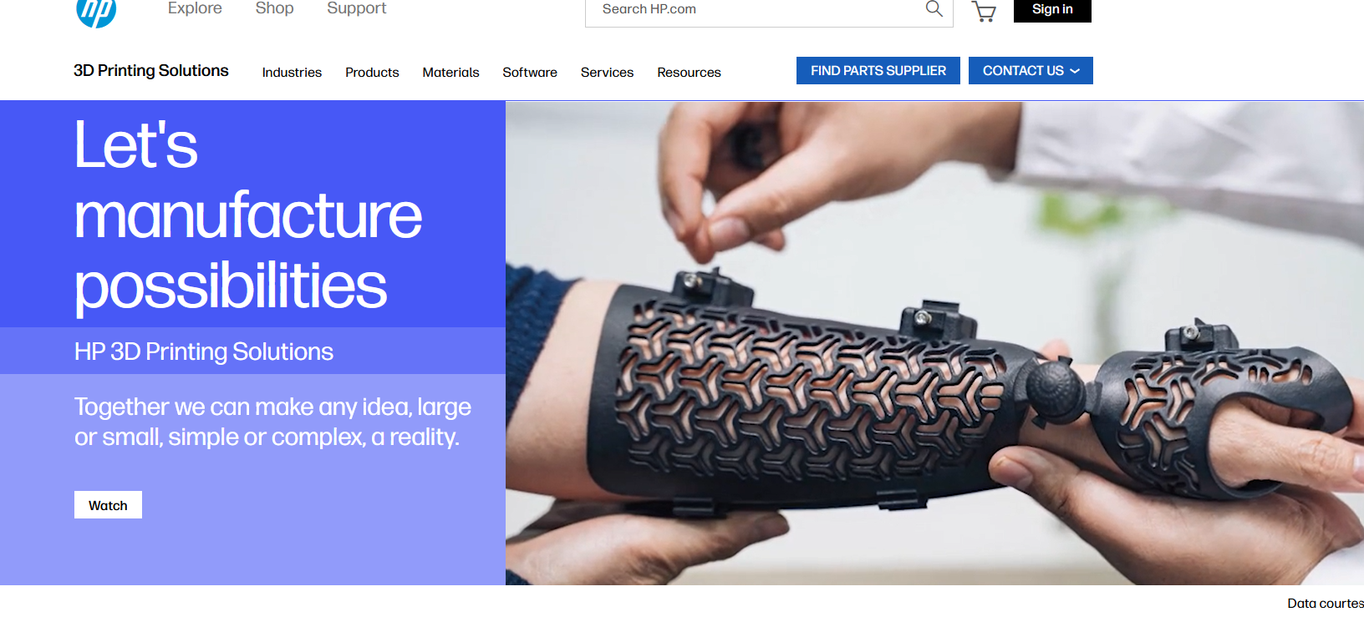

Slide 13
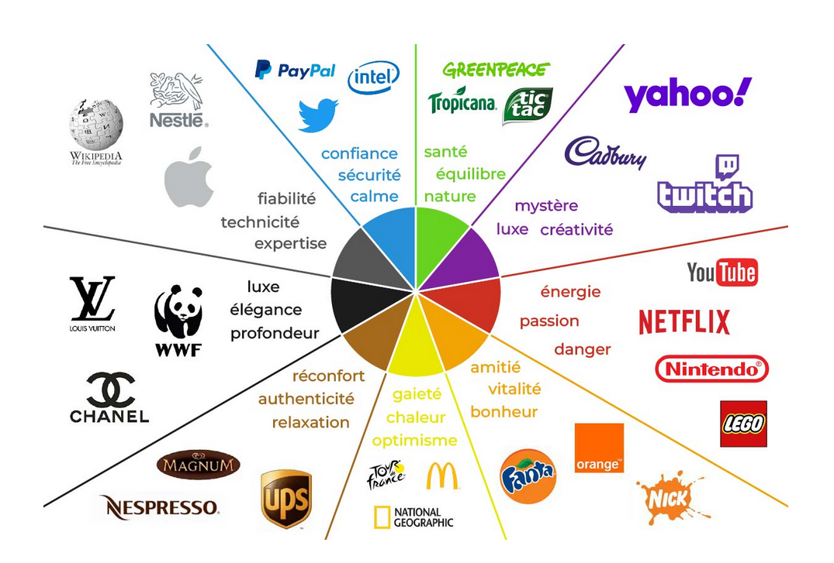

Slide 14
Sources
https://www.graphicstyle.fr/communication/signification-des-couleurs/
https://www.hp.com/us-en/printers/3d-printers.html
Historie de HP
https://leclaireur.fnac.com/article/cp59649-lhistoire-de-hp-un-acteur-historique-de-linformatique/#:~:text=Hewlett%20Packard%20n%C3%A9e%20en%201939,de%20l'universit%C3%A9%20de%20Stanford.

